Slide 1

Phishing Awareness Training
Stay Safe in the Cyber World
Essential knowledge for protecting yourself and your organization from cyber threats in today's connected world.

Slide 2
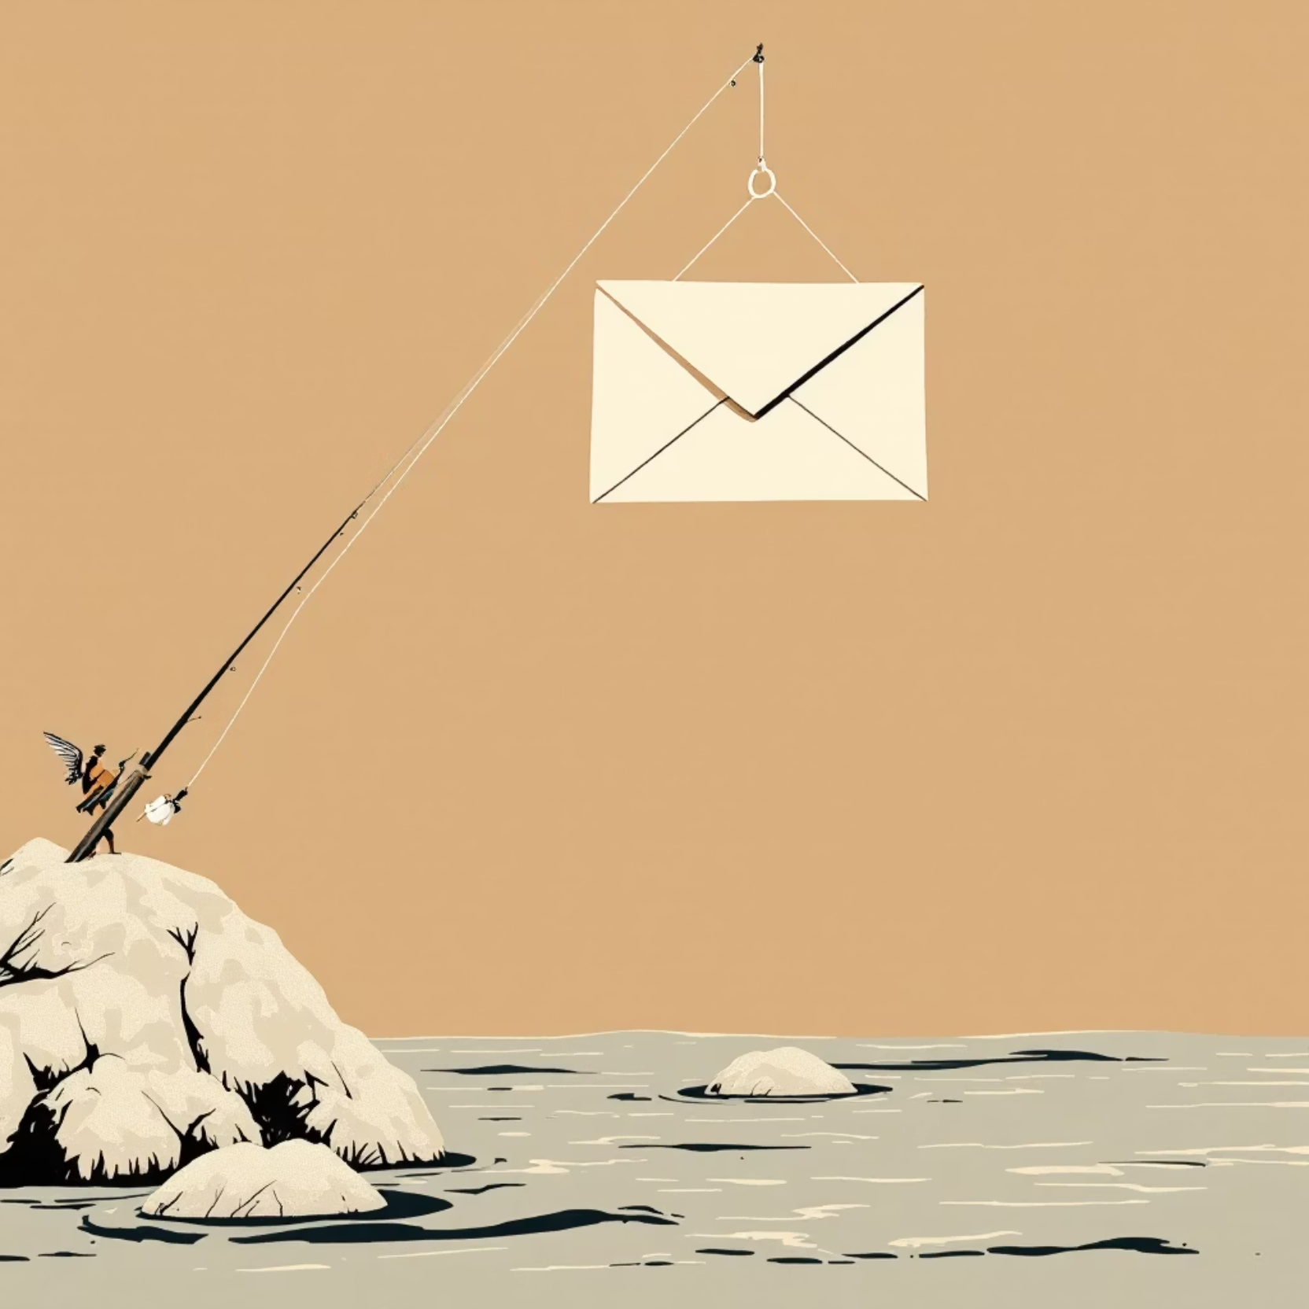
What is Phishing?
Phishing is a sophisticated cyberattack where criminals impersonate trusted sources—like banks, employers, or popular services—to deceive victims into revealing sensitive information.
Common Targets:
Login credentials and passwords
Credit card and banking details
Social Security numbers
Personal identification data
These attacks arrive through emails, text messages, phone calls, or convincingly fake websites designed to look authentic.

Slide 3

How Phishing Attacks Work
01
02
Impersonation
Manipulation
Attackers craft fake messages that closely mimic legitimate organizations, using stolen logos and professional formatting to appear trustworthy.
They exploit urgency, fear, or curiosity—claiming your account is compromised, you've won a prize, or immediate action is required to avoid consequences.
03
04
Interaction
Exploitation
Victims are tricked into clicking malicious links, downloading infected attachments, or directly providing credentials on fake login pages.
Once you interact, attackers can install malware, steal your credentials, access your accounts, or use your information for identity theft and financial fraud.

Slide 4
Common Types of Phishing
Email Phishing
Spear Phishing
Mass emails sent to thousands of people pretending to be banks, retailers, or government agencies. The most widespread form of attack.
Highly targeted attacks using personal information about you. Accounts for 91% of successful data breaches due to customization.
Smishing
Vishing
Phishing delivered via SMS or text messages, often claiming to be delivery notifications, account alerts, or prize winnings.
Voice phishing conducted through phone calls where scammers impersonate tech support, IRS agents, or bank representatives.

Slide 5
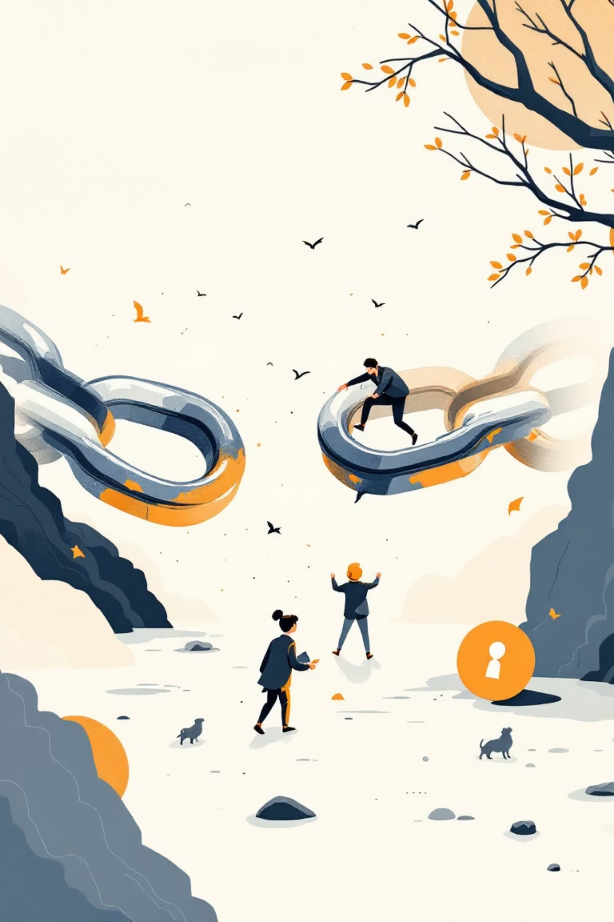
Real-World Examples
The Million-Dollar Invoice Scam
University Password Breach
A major tech company lost millions when finance employees received fake invoices from what appeared to be a trusted vendor. The payment went directly to fraudsters who had meticulously researched the company's payment processes.
Attackers impersonated a university IT department, sending emails about "mandatory password updates." Hundreds of students and staff entered credentials on a fake login page, compromising sensitive academic records and personal data.
Delivery Notification Trap
Smishing texts claiming to be from FedEx, UPS, or USPS with urgent package delivery issues. Clicking the link installed malware that captured banking apps and personal messages on victims' phones.

Slide 6
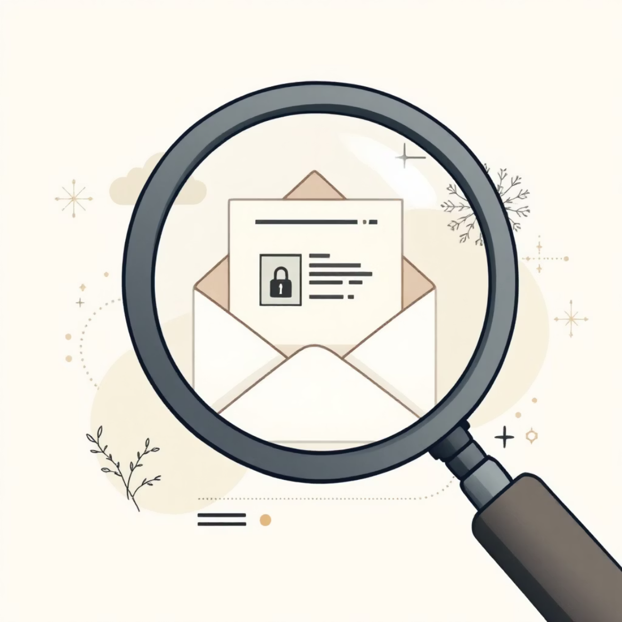

Warning Signs to Watch For
Unexpected Messages
Unsolicited emails or texts from organizations you don't recognize or weren't expecting to hear from.
Urgent Language
Demands for immediate action using fear tactics like "Your account will be closed" or "Verify within 24 hours."
Poor Grammar
Spelling mistakes, awkward phrasing, or unprofessional formatting that legitimate companies wouldn't send.
Suspicious Sender
Email addresses that don't match official domains—check carefully for slight misspellings or extra characters.
Generic Greetings
"Dear Customer" instead of your actual name, indicating a mass phishing campaign rather than legitimate correspondence.
Pro Tip: Always hover over links before clicking to preview the actual URL destination. Never click first and ask questions later.

Slide 7

How to Identify Fake Links
Inspect the Domain
Hover First, Click Never
Look for misspellings, extra characters, or wrong extensions. "paypa1.com" (with number 1) instead of "paypal.com" or "amazon-security.net" instead of "amazon.com" are red flags.
Place your mouse cursor over any link without clicking. The real URL will appear at the bottom of your browser or in a tooltip. Compare it carefully to the expected destination.
Check Security Indicators
Type It Manually
Legitimate sites use HTTPS (not just HTTP) and display a padlock icon in the address bar. However, note that phishing sites can also have these—they're necessary but not sufficient for security.
When in doubt, don't click the link. Instead, type the official website address directly into your browser or use a trusted bookmark you created yourself.

Slide 8
Best Practices to Stay Safe
Protect Your Credentials
Enable Two-Factor Authentication
Keep Systems Updated
Never share passwords or personal information via email, text, or phone calls. Legitimate organizations will never ask for this information through these channels.
Regularly update your operating system, browsers, and antivirus software. Security patches fix vulnerabilities that attackers actively exploit.
Add an extra security layer to all accounts by requiring a second verification step beyond your password, such as a code sent to your phone.
Report Suspicious Activity
Back Up Important Data
Forward suspicious emails to your IT or security team immediately. Quick reporting can prevent others from falling victim to the same attack.
Regularly backup critical files to secure cloud storage or external drives. This protects you from ransomware and data loss from successful attacks.

Slide 9
Quick Quiz: Spot the Phish!
Test your phishing detection skills with these scenarios:
1
2
3
Bank Password Email
Prize Notification Text
Misspelled Official Email
You receive an email from your bank asking you to verify your password urgently due to "suspicious activity." The email includes a link to update your credentials immediately.
An unknown number texts you claiming you've won a $1,000 gift card. "Click this link within 2 hours to claim your prize before it expires!"
You receive a professional-looking message about a package delivery. The sender's email is "support@ups-delivery.net" instead of the official UPS domain. The message formatting looks legitimate.
Answer: IGNORE! Classic smishing attack using urgency and false rewards. Delete immediately and never click unsolicited prize links.
Answer: FALSE - Phishing! Banks never ask for passwords via email. Always log in through the official app or website directly.
Answer: SUSPICIOUS! The wrong domain is a major red flag. Verify independently by visiting the official UPS website directly.

Slide 10

Think Before You Click
Your Caution is Your Best Defense
Stay informed about emerging threats
Phishing attacks are everywhere in today's digital landscape, constantly evolving with new tactics and technologies. Cybercriminals are betting on human error—your vigilance breaks that chain.
Remain alert to suspicious messages
Always verify unexpected requests through official channels before taking action. When something feels off, trust your instincts and investigate further.
Protect your digital life every day
Thank you for learning to stay safe! Remember: a moment of caution can prevent a lifetime of consequences.

